Slide 1
URBAN REDEVELOPMENT
NEW BRUNSWICK PERSPECTIVES:
New Brunswick Redevelopment – Heldrich & Rockoff
Christopher J. Paladino
President, New Brunswick Development Corporation

Slide 2
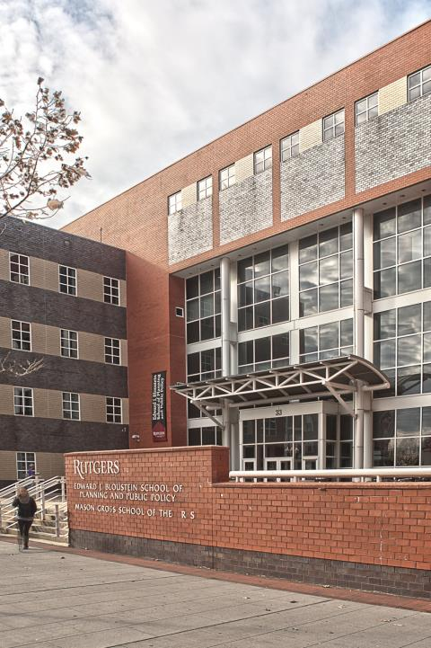

Slide 4
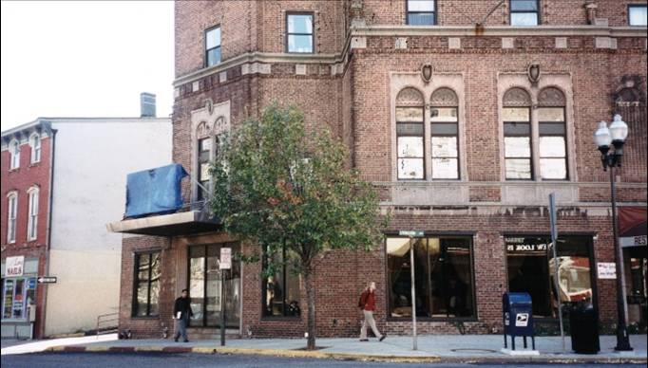

Slide 5
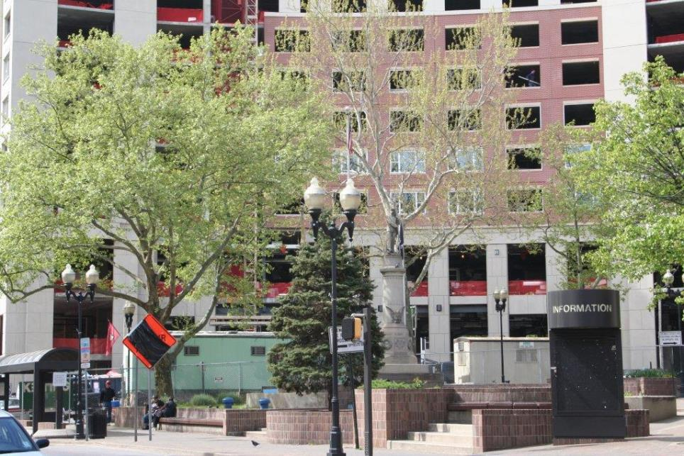

Slide 6
Other old park pic

Slide 7
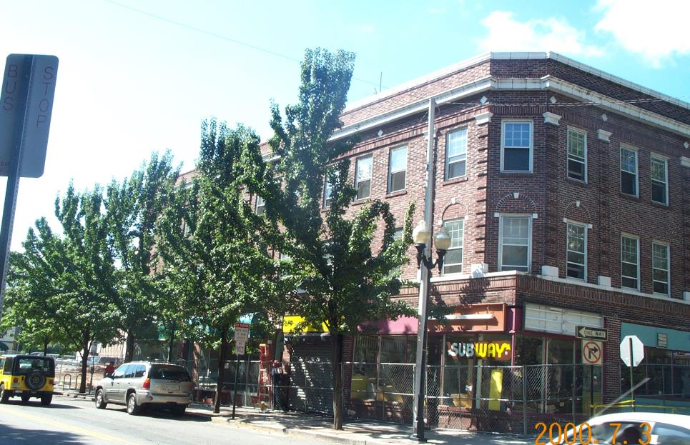

Slide 8
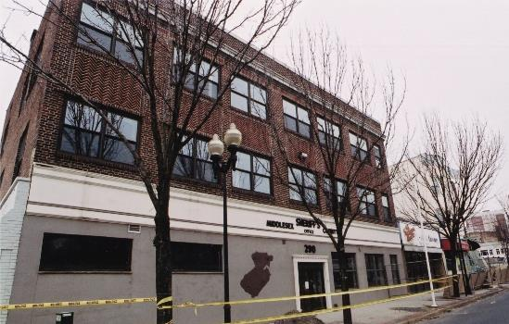

Slide 10
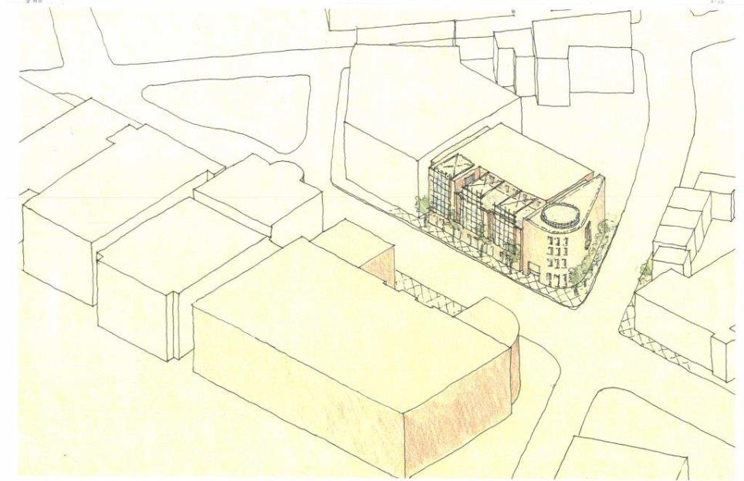

Slide 11
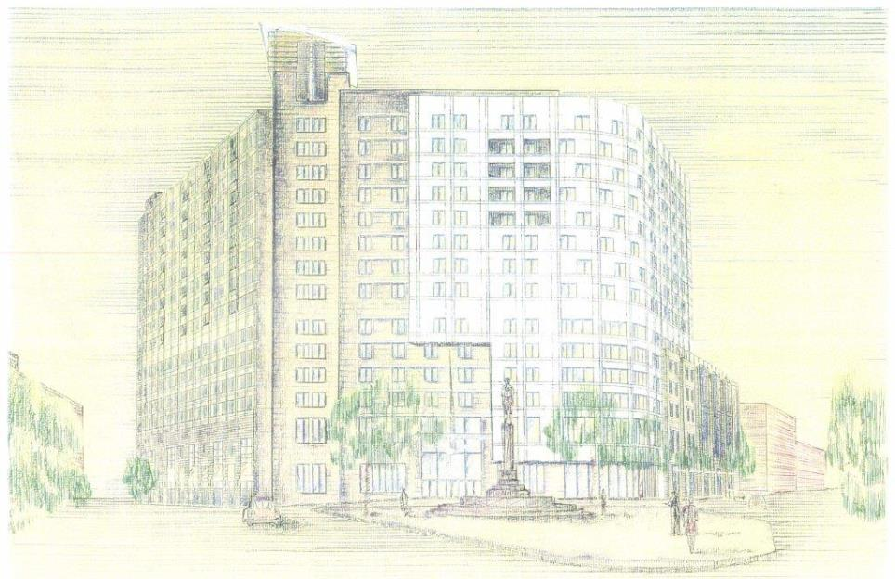

Slide 12
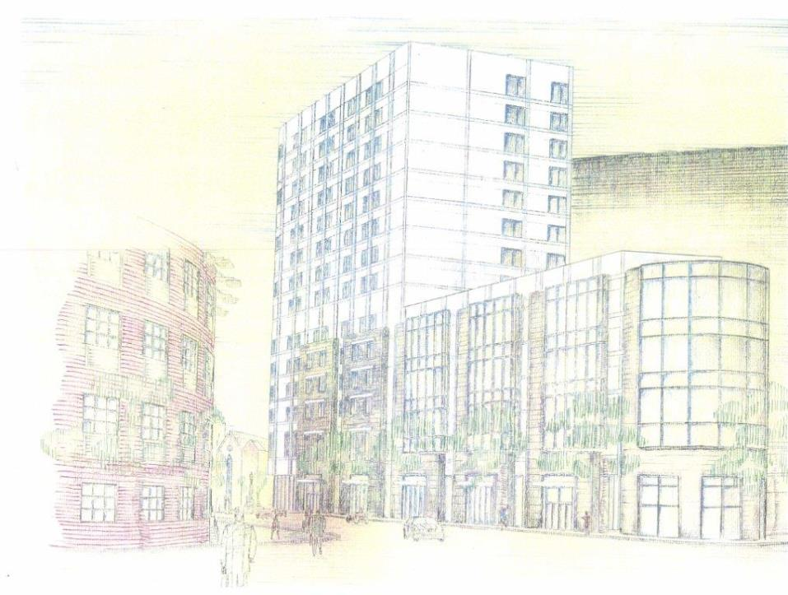

Slide 14
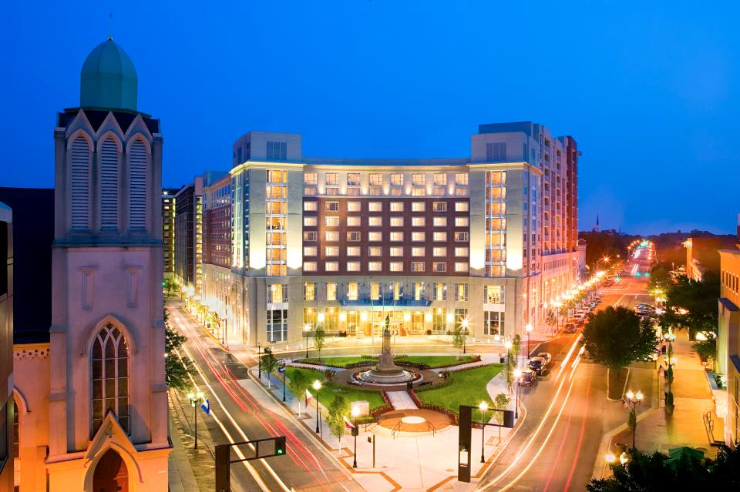

Slide 24
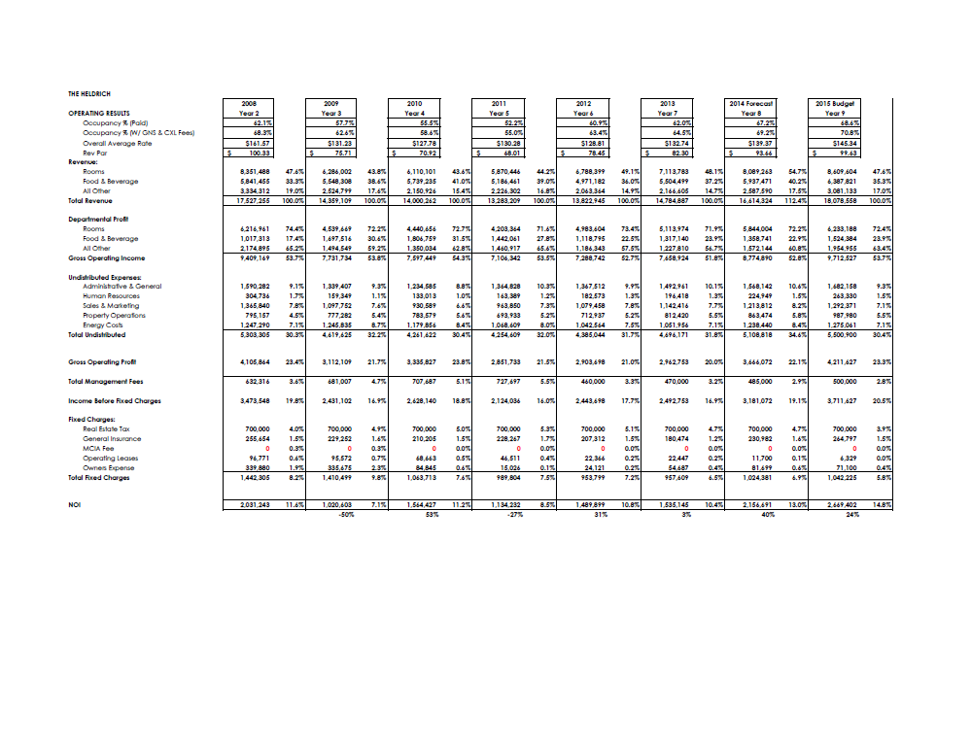

Slide 26
Viability of a New Student Housing Project to be Developed by Devco
With regard to the new, approximately 670-bed facility proposed for downtown New Brunswick, Scion has attempted to answer the following questions:
Does demand exist for Devco to provide downtown student housing, and can such housing be provided at rates that will allow the project to be self-sustaining?
What are desirable specifications for such housing, in terms of physical layout as well as legal/operational issues, including retail pricing, contract length, summer usage, etc.?

Slide 27
There is a high demand for on-campus, quality housing.
Recommend mix of housing options; graduate student option of 1 bedroom units and undergraduate double occupancy units
Assume graduate students will require 12-month contracts with undergraduates electing for either 9.5-month or 12-month contracts.
Recommend a university guarantee for a period of time with long term University involvement.
Housing is critical to University operations and the students demands are currently unmet.
Students want access to on-campus housing and will pay higher prices for housing with more space and privacy.
Students are actually paying more for off campus housing but believe it is a better value due to more space and privacy.

Slide 28
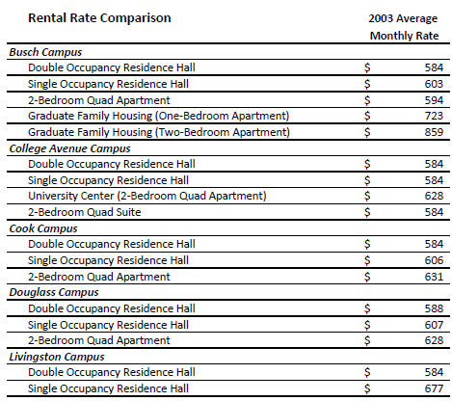
Please note that rates contained above were calculated by using Rutgers’ advertised room rates, plus fees for residence life, telephone and fire sprinklers (where applicable), then divided by the approximate length of occupancy to achieve a monthly rate.
Most Rutgers properties do not permit student access during school vacations (University Center and the Rutgers project are among the few that do provide access). However, no rates have not been adjusted to reflect these periods.

Slide 29
Students report paying the following monthly costs to live off-campus, though it should be noted that not all students have identical utilities and amenities as are offered on-campus (e.g., Internet access, cable television, furnished unit):
Freshman $555
Sophomores $601
Juniors $563
Seniors $555
New graduates $644
Returning graduates $695
Many students also feel that the condition of local housing (marketed primarily to students) is in fair to poor condition. Students also feel that landlords, due to their “captive” market of students, charge premium prices yet are generally unresponsive to many tenant needs and concerns. Naturally, this observation is typical of the housing found near many large college campuses, and the most likely remedy to this situation is aggressive competition for student renters by attractive properties, offered either by the University or third parties.
Overall, the local off-campus market provides a substantial inventory of housing at rates that are affordable to students. Based on our research, however, as well as the discussions among focus group attendees, the off-campus housing market does not necessarily offer a balance between the cost and the quality of living. The aged physical condition, inadequate living space and limited amenities of off-campus housing have substantially affected residents’ satisfaction levels. Therefore, we believe that providing newer and more affordable housing on-campus will be particularly attractive to Rutgers students.

Slide 30
The potential demand for Rutgers student housing is sustainable and would support self-sustaining rental rates.
Of all respondents, a substantial majority report that they would be willing to spend $600 to $800 per person, per month for certain configurations of Rutgers housing.

Slide 31
Proximity to classes is a key factor, followed by cost, adequate living space and physical condition of housing.
As could be expected, over 63% of respondents say “proximity to class” was an important factor in their choice of their current residence. Notably, however, this factor is directly followed in frequency by “cost” (58%), “adequate living space” (39%) and “physical condition of housing” (37%). Other significant factors include Internet access, ability to live with friends, safety/security and ability to meet other students.

Slide 32
There is a strong preference for traditional apartment configurations.
The respondents exhibit a significant consensus preference for apartments versus semi-suite setup. Indeed, nearly half of all respondents are not interested at any price in a “semi-suite” with limited kitchen facilities. Meanwhile, a strong majority of respondents indicated a positive interest, at varying price levels, in all of the apartment styles, especially the two-bedroom double and four-bedroom quad apartments.

Slide 34
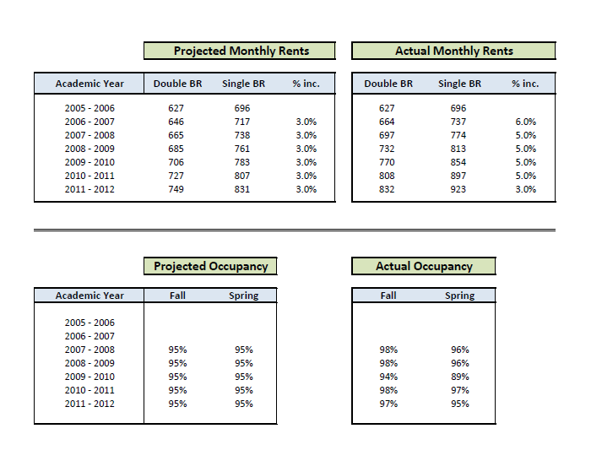

Slide 35
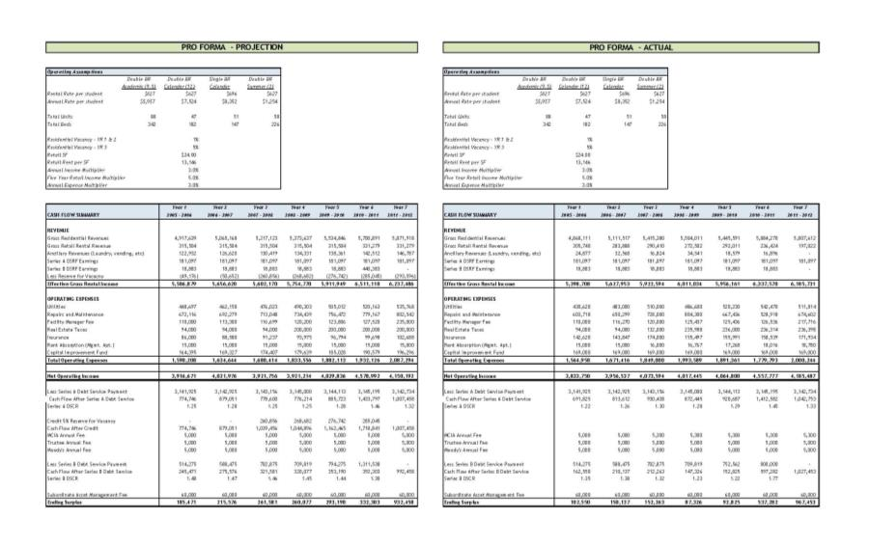

Slide 36
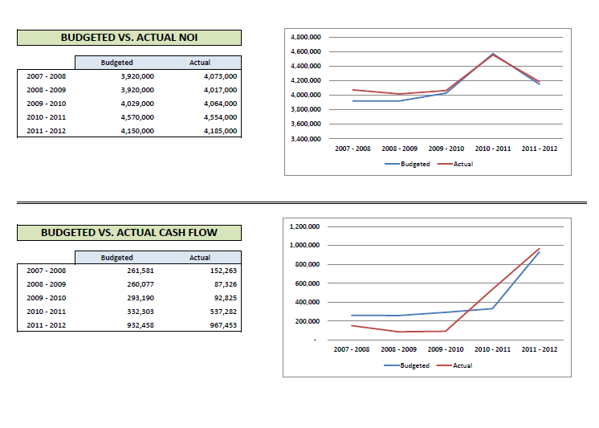

Slide 37
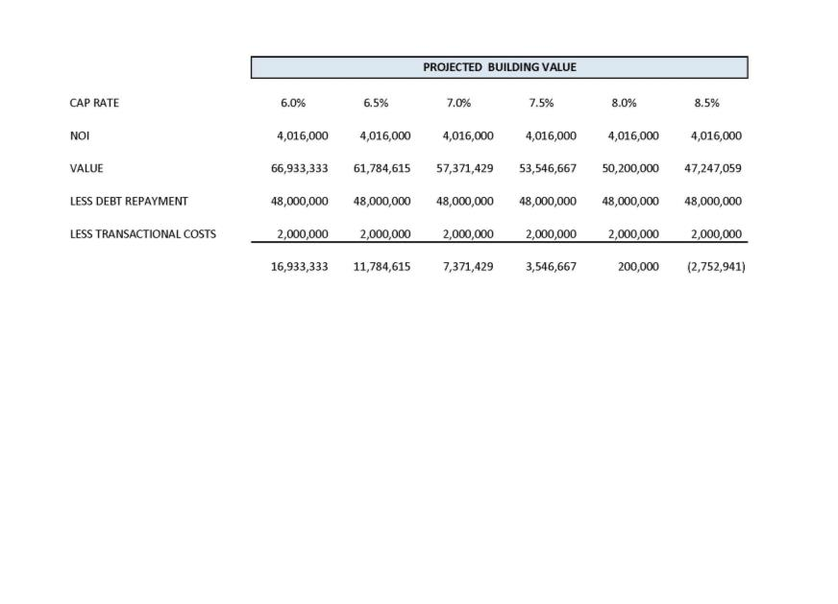

Slide 38
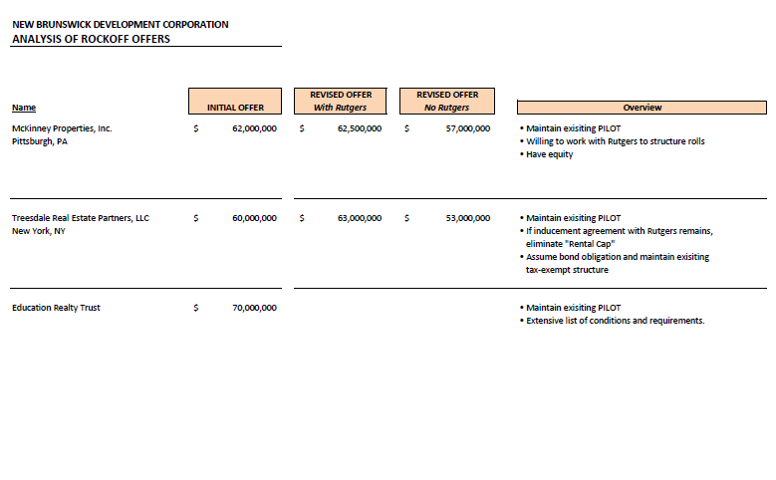

Slide 39
